Slide 1
Volvo Group Trucks Technology
Active Safety

Slide 2
Syfte
Visa hur vi arbetar idag
Diskutera fram ett förlag på hur vi ska göra

Slide 3
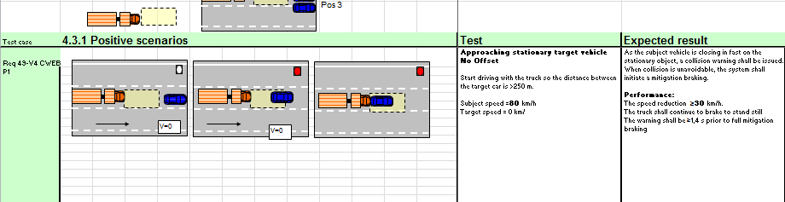
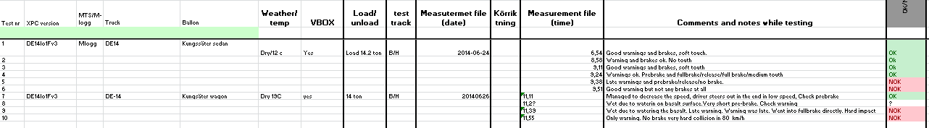
Excelsheet used for documenting all positive test scenarios

Slide 4
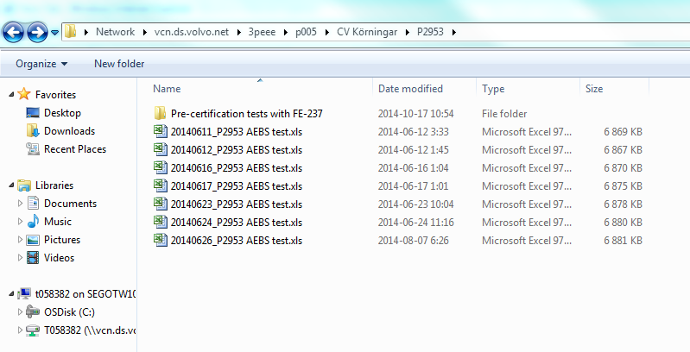
Uploading the excel sheet on the server storage place

Slide 5
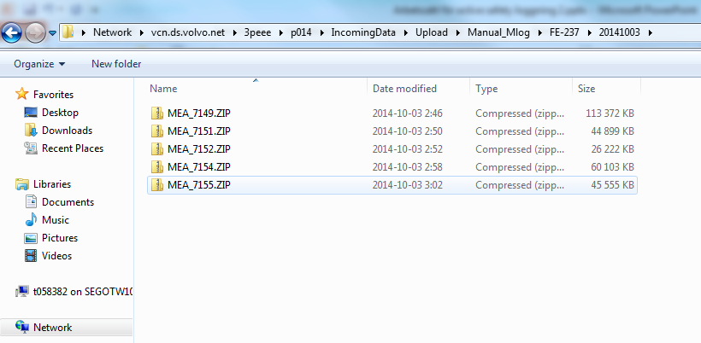
We put up the non converted data from the M-logger

Slide 6
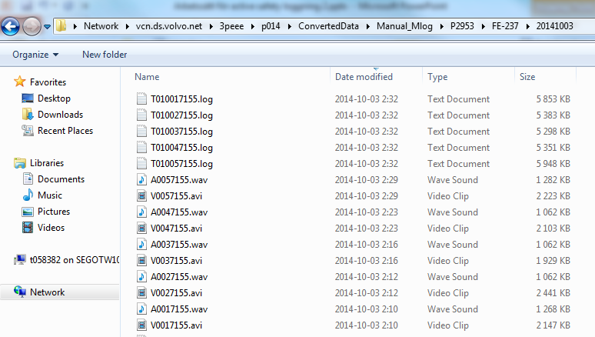
We manually convert the M-logger files with IPE-converter and upload them to the server

Slide 7
Next step
We put a mail to Peter Eriksson about that we have uploaded new data
We put a mail to the developers that we have uploaded new data

Slide 8
Vad händer sen:
Peter Eriksson has to:
Manual conversion to Matlab
Send out information to all people that could be interested in this data together with a path
Developer has to:
Put a lot of effort to find the correct logfile
Redo each procedure for all the searches to find the correct logfile

Slide 9
Summary
We work with a static excel sheet
There is no physical link between the excel sheet and the logfile
Sometimes it is quicker to go up to proving ground and redo the test than spending time searching for log file

Slide 10
To be more cost efficient regarding logging/analysing data, we need a more powerful tool

